Slide 1

Note: The data and information in this document is reflective of a hypothetical situation and client. This document is to be used for KPMG Virtual Internship purposes only.
Sprocket Central Pty Ltd
Data analytics approach
[Division Name] - [Engagement Manager], [Senior Consultant], [Junior Consultant]

Slide 2
Note: The data and information in this document is reflective of a hypothetical situation and client. This document is to be used for KPMG Virtual Internship purposes only.
Agenda
Introduction
Data Exploration
Model Development
Interpretation

Slide 3
Note: The data and information in this document is reflective of a hypothetical situation and client. This document is to be used for KPMG Virtual Internship purposes only.
Introduction
Identify and Recommend Top 1000 Customers to Target from Datasets
Outline of Problem
Contents of Data Analysis
Sprocket Central is a company that specializes in high-quality bikes and cycling accessories.
Their marketing team is looking to boost business sales by analyzing provided dataset.
Using three datasets provided the aim is to analyze and recommend 1000 customers that Sprocket Central should target to drive higher value for the company.
‘New’ and ‘Old’ customers Age Distribution
Bike related purchases over the last 3 year by gender
Job industry distributions.
Wealth segment distribution
Numbers of cars owned and not owned by state
RFM analysis and customer classification
This will be done in three phases of : Data Exploration, Modal Development and Interpretation.

Slide 4
Note: The data and information in this document is reflective of a hypothetical situation and client. This document is to be used for KPMG Virtual Internship purposes only.
Data Exploration
Data Quality Assessment and ‘Data Cleaning’
Key Issue for Data Quality Assessment
Summary Table
Accuracy : Correct Values
Completeness : Data Fields and Values
Consistency : Values Free from Contradiction
Currency : Value up to date
Relevancy : Data items with value Meta-data
Validity : Data containing allowable values
Uniqueness : Records that are duplicated
 | Accuracy | Completeness | Consistency | Currency | Relevancy | Validity
Customer Demographic | DOB: inaccurate Age : missing | Job Title : Blanks Customer id : Incomplete | Gender : Inconsistency | Deceased customer : filter out | Default column : delete
Customer Address |  | Customer id : Incomplete | States : Inconsistency
Transactions | Profit : missing | Customer id : Incomplete Online order : Blanks Brand: blanks |  |  | Cancelled order status : Filter out | List price : Format Product sold date : format
An In-depth analysis has been sent by email.

Slide 5
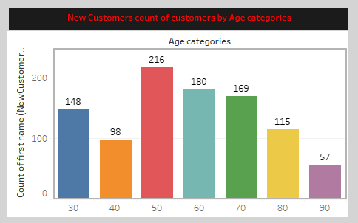
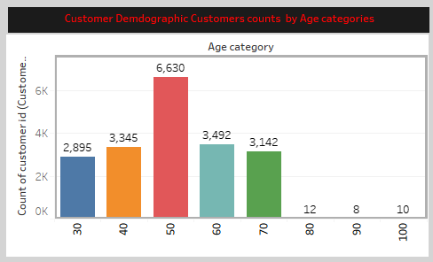
Note: The data and information in this document is reflective of a hypothetical situation and client. This document is to be used for KPMG Virtual Internship purposes only.
Data Exploration
‘New’ and ‘Old’ customers Age Distribution
Most customers are between 40-49 in ‘New’. In ‘Old’ majority of customers are also aged between 40-49.
The lowest age group in ‘New’ is from 80-89 and in ‘Old’ is from 80-89 and 90-99
The ‘NEW CUSTOMER LIST’ suggests that age group 20-29 and 40-69 are most populated.
The ‘OLD CUSTOMER LIST’ list suggest age group from 20-69 is most populated. Among them 40-49 id highest.
There is steep drop of customers in the 30-39 age group in ‘NEW’.
There is steep drop of customers in the 71-99 age group in ‘OLD’.

Slide 6
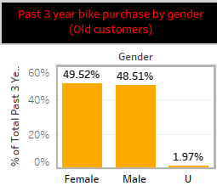
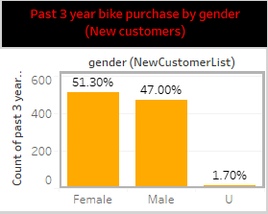
Note: The data and information in this document is reflective of a hypothetical situation and client. This document is to be used for KPMG Virtual Internship purposes only.
Data Exploration
Bike related purchases over last years by gender
Over last three years about 49.5% of bike related purchases were made by females and 48.5% of purchases are made by males. Approximately 1.97% were made by unknown genders in ‘OLD CUSTOMER LIST’.
Similarly, In ‘NEW CUSTOMER LIST’ 51.30% bike related purchases were made by females and 47% purchases were made by males. Approximately 1.7% were made by unknown genders.
Females make up majority of bike related purchases sales in both the lists.

Slide 7
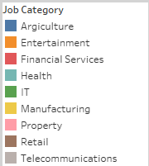
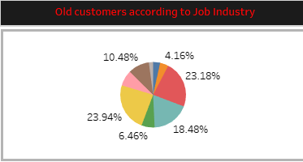
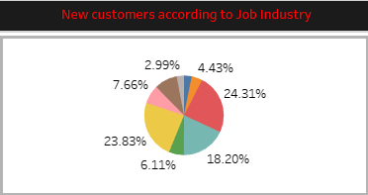
Note: The data and information in this document is reflective of a hypothetical situation and client. This document is to be used for KPMG Virtual Internship purposes only.
Data Exploration
Job Industry Distribution
In ‘OLD CUSTOMER LIST’ most customers works in Manufacturing and Financial Services i.e. 23.9% and 23.1% respectively.
Similar pattern can be seen in ‘NEW CUSTOMER LIST’ 23.% in Manufacturing and 24.3% in Financial Services.
The smallest numbers of customers works in Agriculture and Telecommunication sector in both the list.

Slide 8
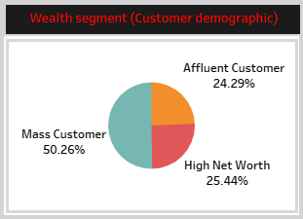
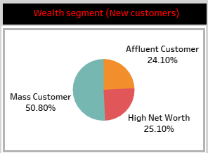
Note: The data and information in this document is reflective of a hypothetical situation and client. This document is to be used for KPMG Virtual Internship purposes only.
Data Exploration
Wealth Segmentation of customers
In ‘OLD CUSTOMER LIST ‘ Most of our customers belongs to the segment “Mass Customer” i.e. approximately more then 50%.
Similarly we can see in the ‘NEW CUSTOMER LIST’ same pattern is followed i.e. most of new customers belongs to “Mass Customers” segment which approximately more then 50%.
Remaining 2 segments which are “Affluent Customer” and “High Net Worth” shares 25% of customer counts in both the lists.

Slide 9
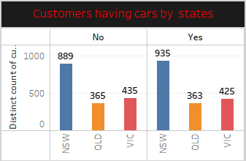
Note: The data and information in this document is reflective of a hypothetical situation and client. This document is to be used for KPMG Virtual Internship purposes only.
Data Exploration
Number of cars owned and not owned by gender and states
NSW has largest the largest amount of the people that do not own car. NSW seem to have a higher number of people from which data is collected . As NSW also has highest number of people who own cars with respect to other states.
VIC state is also split quite evenly . But both numbers are significantly lower than those of NSW.
QLD is lowest among all states that has owns cars.

Slide 10
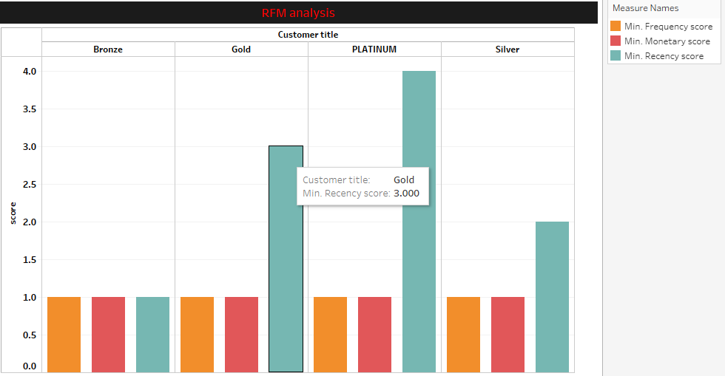
Note: The data and information in this document is reflective of a hypothetical situation and client. This document is to be used for KPMG Virtual Internship purposes only.
Model Development
RFM Analysis and Customer Classification
RFM analysis is used to determine which customer a business should target to increase its revenue and value.
The RFM (Recency , Frequency and Monetary) model shows customers that have displayed high levels of engagement with the business in three mentioned categories.

Slide 11
Note: The data and information in this document is reflective of a hypothetical situation and client. This document is to be used for KPMG Virtual Internship purposes only.
Model Development
Scatter plot based off RFM Analysis
The chart shows that customers who purchased more recently have generated more revenue , than customer who visited a while ago.
Customers from recent past (50-100 days) also show to generate a moderate amount of revenue.
Those who visited more than 200 days ago generated low revenue.

Slide 12
Note: The data and information in this document is reflective of a hypothetical situation and client. This document is to be used for KPMG Virtual Internship purposes only.
Model Development
Scatter plot based off RFM Analysis
Very low frequency of 0-2 corelated with high frequency values .i.e. More then 250 days ago.
Customers that have visited more recently(0-50 days) have a higher chance of visiting more frequently(6+).
Higher frequency has a negative relation with recency values. Such that very recent customers are also frequent customers.

Slide 13
Note: The data and information in this document is reflective of a hypothetical situation and client. This document is to be used for KPMG Virtual Internship purposes only.
Model Development
Scatter plot based off RFM Analysis
As Frequency increases the Monetary is also increase.
This graph shows the positive relationship between the Frequency and Monetary.
We can conclude that as the frequency will increase there will be increase in profit.

Slide 14
Note: The data and information in this document is reflective of a hypothetical situation and client. This document is to be used for KPMG Virtual Internship purposes only.
Interpretation
Summary table of Top 1000 Customers to Target
Rank | Customer Title | Number of Customers | Cumulative | Customer Selection
1 | PLATINUM | 817 | 817 | 817
2 | GOLD | 845 | 1162 | 183
3 | SILVER | 956 | 2618
4 | BRONZE | 874 | 3492
Filter through the top 1000 customers by assigning the conditions discussed in the table above.
The 1000 customers discovered would have bought recently, they have bought very frequently in the past and tend to spend more then other customers.

Slide 15
Note: The data and information in this document is reflective of a hypothetical situation and client. This document is to be used for KPMG Virtual Internship purposes only.
Appendix

Slide 16
Note: The data and information in this document is reflective of a hypothetical situation and client. This document is to be used for KPMG Virtual Internship purposes only.
Appendix
This is an optional slide where you may place any supporting items.

